Slide 1

Human Trafficking Data Analysis
Project 1:
Elizabeth Harrison
Lisa Jemmings
Shirley Limburg
Saron Raut
Mara Schemel
Sumit Patel
Notes:
Lisa
Hello, everyone. I’m Lisa and along with Liz, Shirley, Saron, Mara, & Sumit, our group decided to study the demographics of human trafficking.
Our presentation is pre-recorded for the sake of efficiency, but we will take questions live at the end.

Slide 2

Fight the Plague of Human Trafficking
Atlanta Hartsfield-Jackson Airport
U.S. 2019 Human Trafficking: ~11,500 Cases
Global Human Trafficking: ~20.8 Million Cases
$150 Billion Illegal Global Industry
Research Questions:
How do people become trafficked? What keeps them trapped?
What are the source and destination countries for human trafficking?
In which industries are trafficked persons most likely to be exploited?
Do economic factors influence the likelihood of being trafficked?
Notes:
Lisa
Script: Given that most of us live in the metro Atlanta area, we chose this topic because our Hartsfield-Jackson airport is known as one of the biggest hubs for human trafficking in the world.
In the US alone, there have been 11,500 human trafficking cases reported in 2019. Worldwide there are an estimated 20.8 million human trafficking victims, which contribute to a $150 billion dollar illegal global industry.
With this in mind, the questions we want to explore are:
How do people become trafficked? What keeps them trapped? What are the means in which they become trapped in this system?
What are the source and destination countries in the global network of trafficking?
In which industries are trafficked persons most likely to be exploited?
Do economic factors influence the likelihood of being trafficked?

Slide 3
Counter Trafficking Data Collaborative and World Bank
Main Source through Kaggle : CTDC First global data hub on human trafficking
Data contributed from organization around the world
DataBank World Bank
Data on GDP for countries
Poverty and Equity
Countries Governance
World Population Review
Population Density
Notes:
We wanted to do our report on something that is globally relevant, and with the conspiracy theory coming out about Wayfair using furniture for human trafficking. We wanted to really dig down to identify who and how are people being trafficked. We built our idea based on the data set we found on Kaggle which led us to our main source which was CTdatacollaborative.org which is a data hub on human trafficking from organizations around the world. The site contains over one hundred and 8 thousand cases reported and data on hundred and sixty countries of exploitation.
We also wanted to see if there was any correlation between poverty and trafficking. For that we used the data from data.Worldbank.org to look at the Countries GDP and governance.
Lastly, we also wanted to cover our bases on population density for the exploited countries. We imported the dataset from worldpopulationreview.com for population density for the year 2020.

Slide 4
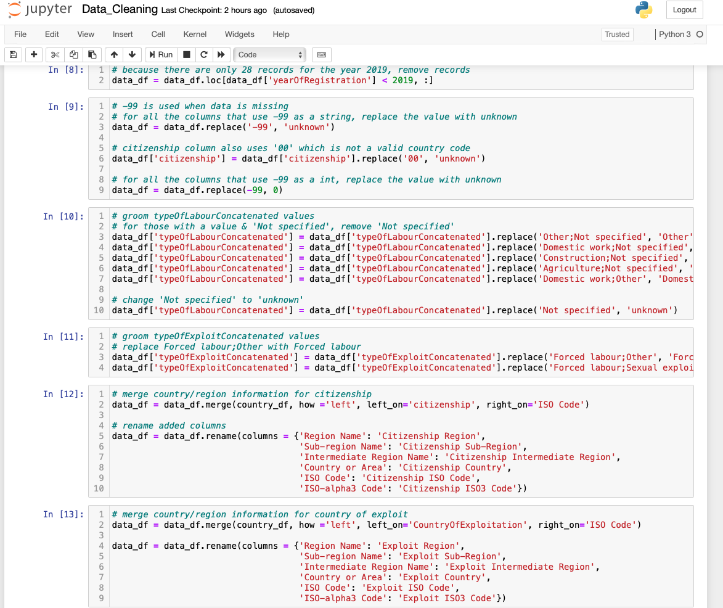
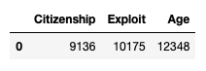
Data Cleanup & Exploration
Unknown Data
Notes:
As a group we reviewed the data selected from Kaggle.
During our exploration together we discussed any changes we needed to make (like replacing/reducing concatenated data) and how we wanted to represent what was missing.
Based on the information provided -99 was used to indicate missing data.
Therefore -99 was replaced with ‘unknown’ or 0 based on the column type.
To further help the analysis, country names and regions were merged into the data set for both citizenship country and exploit country.
After our data clean up, it became clear we had a significant amount of unknowns.

Slide 5
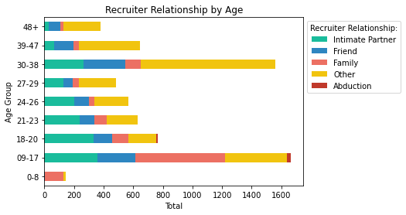
How Do People Become Trafficked?
Recruiter relation varies based on age group
Notes:
SCRIPT:
How do people become Trafficked
Recruiter relation varies based on age group
Intimate Partner: highest count cases are seen for age group 9-17 and 18-20. With lowest cases reported of age 48+
For Recruitment by Friends: more cases are reported for age group 9-17 and 39-47
How do people become Trafficked
Recruiter relation varies based on age group
Intimate Partner: highest count cases are seen for age group 9-17 and 18-20. With lowest cases reported of age 48+
For Recruitment by Friends: more cases are reported for age group 9-17 and 39-47
For age group between 9-17 they are more likely to have a type of family relationship with their recruiter
Out of 39 Abduction cases reported,26 of those cases are for age group 9-17.
Recruitment Relationship Other suggest that there was no immediate relationship with the recruiter. This form of recruitment is most for age group 30-38.
Another take away from this data, tells us that ages between 9-17 and 30-38 are more likely to be recruited for human trafficking. This could due to the type of exploitation that are common for this age group.

Slide 6
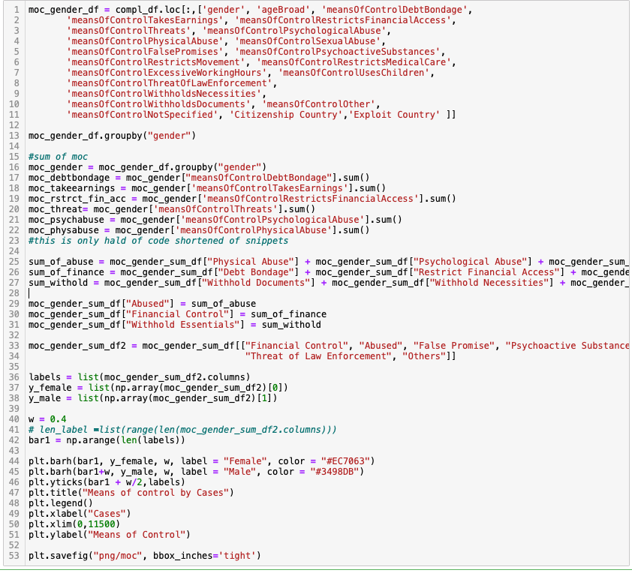
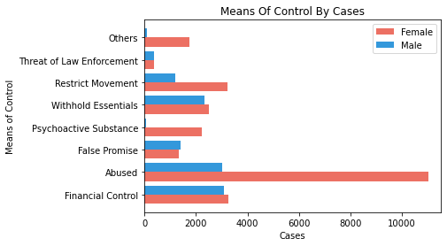
What Keeps Them Trapped?
Means of Control Code
Notes:
SCRIPT:
What Keeps them Trapped:
We wanted to know how Male and Females were control by their traffickers
To answer this question categorized the means control based on similarities:
For Abused: we grouped data for Physical,Psychological,Sexual and Threats
For Financial Control: we looked at the data for Debt Bondage, Restrict Financial Access, Excessive working hours, Earning Control.
And for Withhold Essential: we looked at withhold of documents, neccesities, restrict medical care, control by using children.
Just looking at the graph, we can see that majority of the female cases were controlled through Abused with over 11 thousand cases reported while only around 3 thousand cases were reported for male.
For male the high means of control was through Financial Control while the lowest means of control for male was psychoactive substance.
We also added a little snippet of our code we used to group and create the categorized means of control. We grouped the df by gender and used the .sum() to add all the values in the columns and stored it into a variable. Then created a variable where we added all the sums values based on the appropriate category and then inserted the columns into the df.

Slide 7
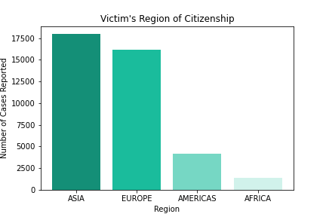
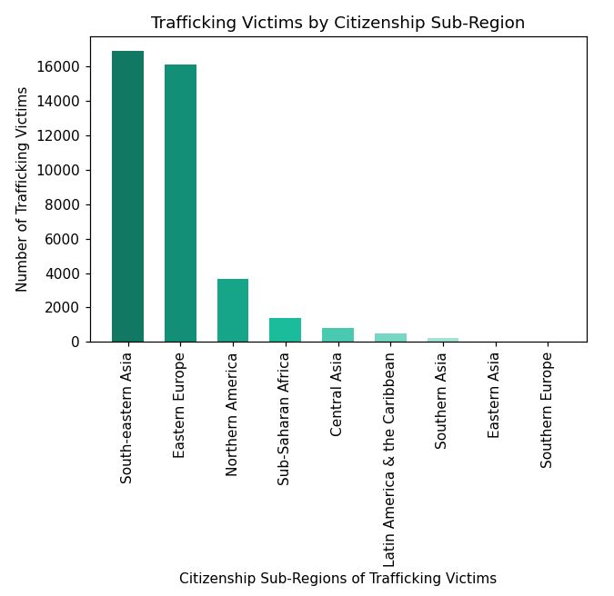
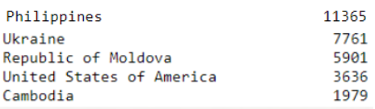
Where are They from?
Top 5 Citizenship Countries
Notes:
SCRIPT:
What Keeps them Trapped:
We wanted to know how Male and Females were control by their traffickers
To answer this question categorized the means control based on similarities:
For Abused: we grouped data for Physical,Psychological,Sexual and Threats
For Financial Control: we looked at the data for Debt Bondage, Restrict Financial Access, Excessive working hours, Earning Control.
And for Withhold Essential: we looked at withhold of documents, neccesities, restrict medical care, control by using children.
Just looking at the graph, we can see that majority of the female cases were controlled through Abused with over 11 thousand cases reported while only around 3 thousand cases were reported for male.
For male the high means of control was through Financial Control while the lowest means of control for male was psychoactive substance.
We also added a little snippet of our code we used to group and create the categorized means of control. We grouped the df by gender and used the .sum() to add all the values in the columns and stored it into a variable. Then created a variable where we added all the sums values based on the appropriate category and then inserted the columns into the df.

Slide 8
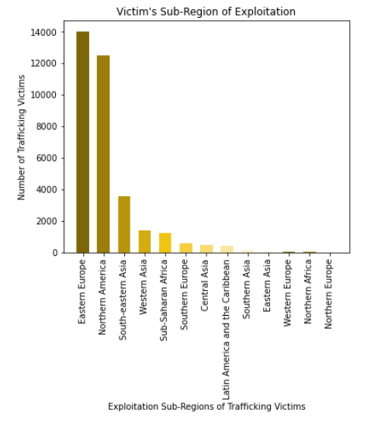
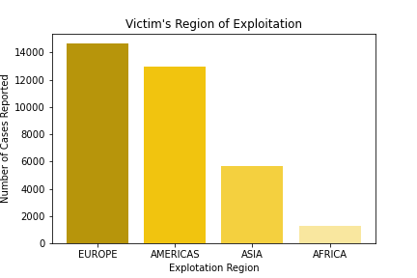
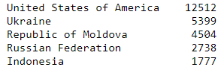
Where do They End Up?
Top 5 Exploitation Countries
Notes:
The majority of trafficking victims are brought to Europe and the Americas to be exploited. The top five countries that trafficking victims are being brought to are the United States, Ukraine, Republic of Moldova, the Russian Federation & Indonesia.

Slide 9
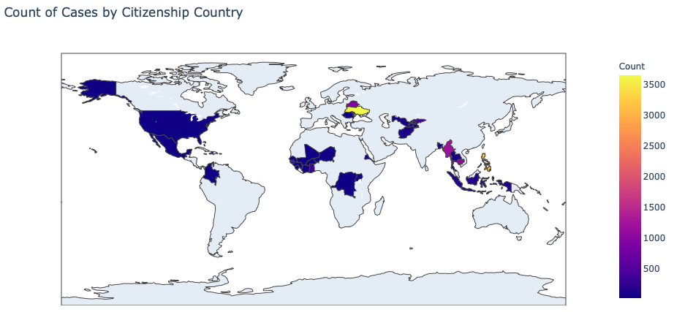
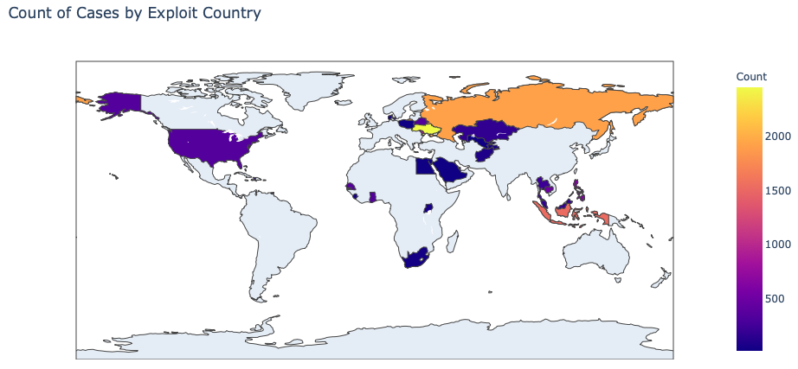
What are the Source & Destination Countries for Human Trafficking?
Notes:
An alternate way we used to show counts of cases was to display the values on maps.
Shown here are choropleth maps. Additional choropleth maps and heatmaps created via google maps are included in our jupyter notebooks and writeup.

Slide 10
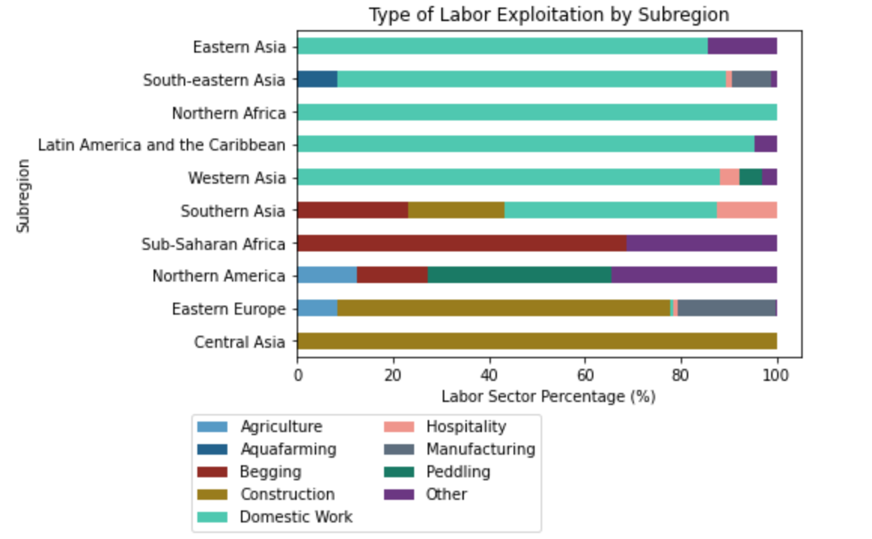
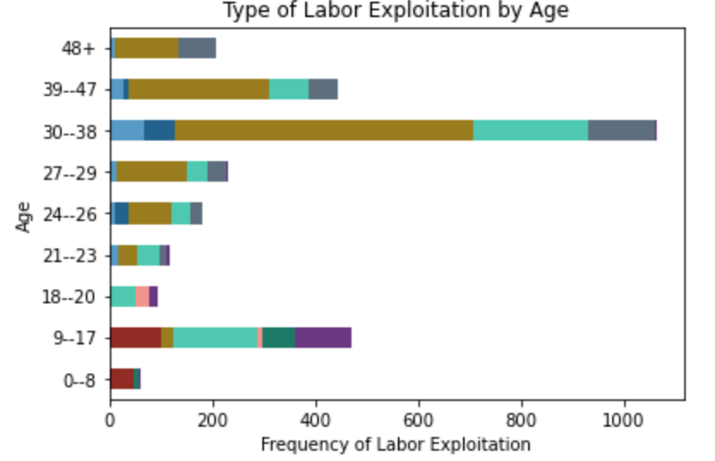
In Which Industries are Trafficked Persons Most Likely to be Exploited?
Domestic Work and Construction Industries are the Greatest Exploiters in Human Trafficking
Notes:
43 seconds
Labor Exploitation Findings:
Overall, Domestic work represents the majority of categorized exploitation cases, followed by Construction with ~25%, and Manufacturing with ~10%.
Central Asia and Eastern Europe labor exploitation is dominated by the construction industry.
Domestic work dominant in South and East Asia, North Africa, and Latin America.
Begging exploitation skews younger, age ranges below 18, and in Sub-Saharan Africa. Construction is the dominant industry for older age ranges.
Females overwhelming majority in Domestic Work, Males overwhelming majority in Construction.

Slide 11
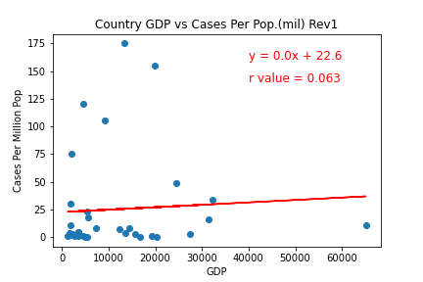
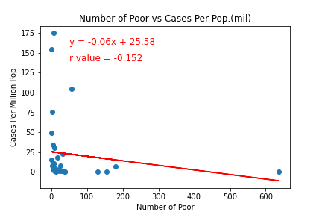
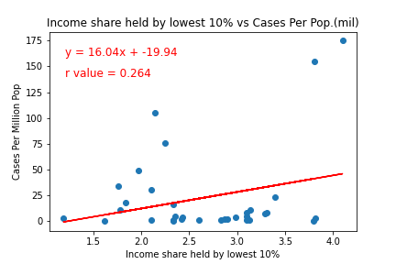
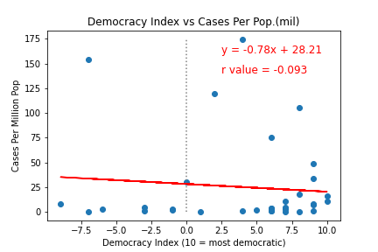
Human Trafficking Can Happen Anywhere in the World
Very Poor / No Correlation between Economic Factors Across Countries of Origin & Cases

Slide 12

Post Mortem
Limitations / Difficulties
Need for larger data set
Finding real correlation
Time Constraints
Rescue / Recovery efforts
Countries with effective anti-trafficking policies
Notes:
Script: Throughout the process of this project, we were met with a few limitations and difficulties. We found given the limited reporting from countries across the globe, it was hard to draw meaningful correlations between the frequency of human trafficking and the countries that it occurs within. In our data set, only 58 countries reported human trafficking cases out of the 195 countries there are in the world.
If we were given an additional two weeks, we would love to explore how human trafficking victims are rescued and recovered. We would also love to analyze which countries had the most effective anti-trafficking policies.
Per GitLab:
Discuss any difficulties that arose and how you dealt with them
Discuss additional questions that came up and you didn’t have time to answer
What would you have done if you had an additional two weeks?
Actual correlation between frequency of human trafficking with some kind of country data
Getting a larger data set
No universal system to report human trafficking data
Didn’t cover rescue / recovery efforts for human trafficking
Which countries have effective anti-trafficking policies?

Slide 13
We May Never Completely Know the True Extent of Human Trafficking
National Human Trafficking Hotline
Need help? United States:
1 (888) 373-7888
SMS: 233733 (Text "HELP" or "INFO")
Hours: 24 hours, 7 days a week
Languages: English, Spanish, and 200 more languages
Website: humantraffickinghotline.org
“Human trafficking is a heinous crime happening all around us. The victims—30% of which are children—are subject to forced labour, sexual exploitation and other forms of abuse. We must do more to bring criminals to justice, and help victims rebuild their lives. “ António Guterres
Secretary General of the United Nations

Slide 14

Q&A

Slide 15
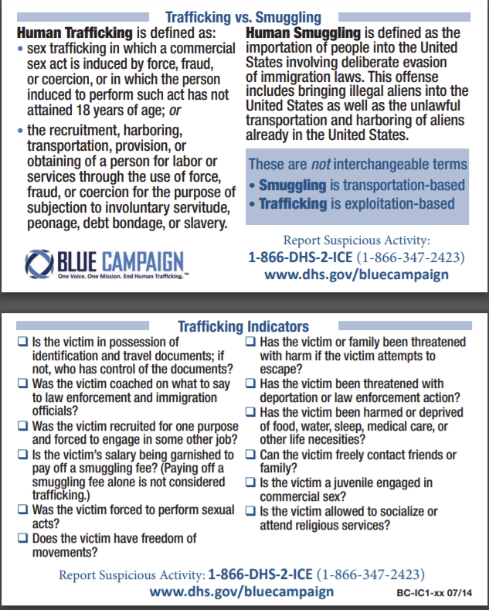
Resources
https://worldpopulationreview.com/state-rankings/human-trafficking-statistics-by-state
https://www.dhs.gov/sites/default/files/publications/20_0115_plcy_human-trafficking-forced-labor-child-exploit-strategy.pdf
https://www.dhs.gov/sites/default/files/publications/4146_CombattingHumanTraffickingThroughSocialScience.pdf
https://data.worldbank.org/,[10,2020]
https://worldpopulationreview.com/ [10, 2020]
https://www.ctdatacollaborative.org [10, 2020]
U.S. Department of Homeland Security

